Slide 1
Music education in Estonia
Harry Illak
Director of Academic Affairs in Univeristy of Tartu Viljandi Culture Acadmey

Slide 2
Secondary schools
Music lessons are mandatory from 1st to 12th grade
Until 5th grade there are 2 lessons per week, after 1 lesson per week
Theoretical kinowledge + practical music making (singing, instrument playing, composing)
Instrument taught are recorder, guitar, 6-string zither (group studies)

Slide 3
Music schools
90 music schools, 13 000 students age 7-18
Funded by local government, parents pay little fee
Two aims – raise professional musicians and to give music education of general interest

Slide 4
Music schools 2
Lessons take place in the afternoon or evening time
Usual workload for a week is approximately 5-9 hours per week

Slide 6
Vocational schools
3 schools: Tallinn Music High School, Georg Ots’ Tallinn Music School and Heino Elleri nimeline Tartu Music school
High schools, which give general education and professional music education

Slide 7
Higher education
3 universities – Estonian Academy of Music and Theatre, Tallinn University, University of Tartu Viljandi Culture Academy
Main centre is EAMT, which provides curricula in all three levels
Tallinn University provides only music teacher training in bachelor and master level

Slide 8
University of Tartu Viljandi Culture Academy
In the Academy – 700 students
4 departments
In the music department – 194 students
You will hear more about music department during next presentation

Slide 9
Outcomes of educational system
2 opera theatres
Nationally funded symphony orchestra
Nationally funded professional male choir
Estonian Philharmonic Chamber Choir
2 professional military wind bands
Composers and musicologists
Lot of smaller musical collectives (to the internationally renowned popular music ensembles)

Slide 10
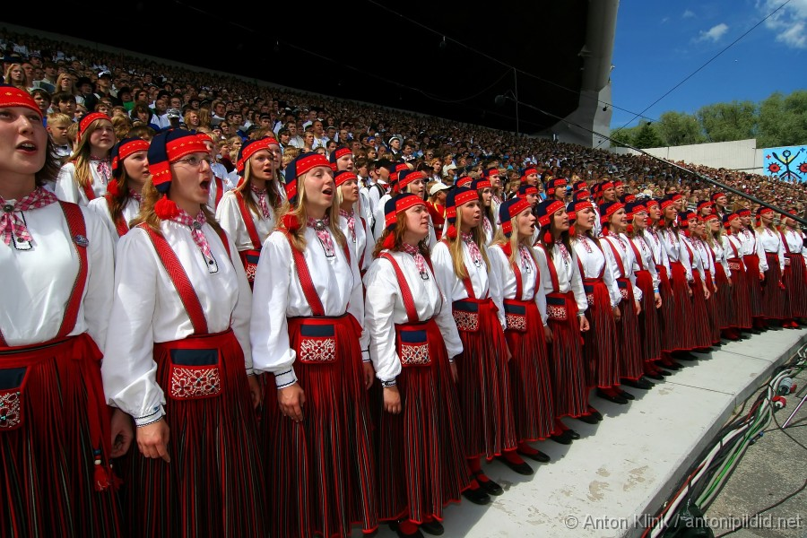
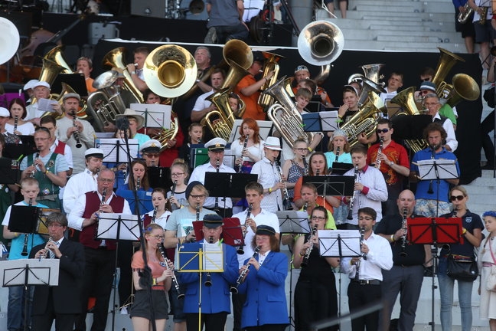
Song Celebration
659 choiers
21 225 singers
91 orchestras
2 500 musician

Slide 11
Song Celebration 2014

